Slide 1
Most Watched Videos
Presentation Of Information

Slide 2
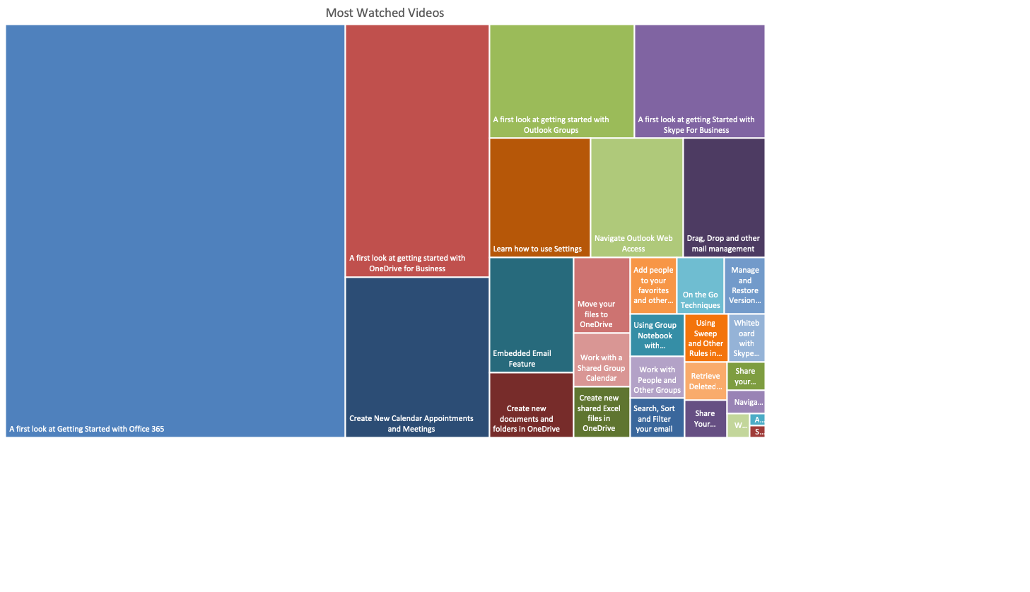
Paste Linked Version: Chart updated as modifying the source of excel file

Slide 3
Paste as picture: will not update automatically

Slide 4
Embed option: allowing update the data and change the chart, but the source file won’t be effected

